Slide 1

Squash The Bugs!
Java One4 kids 2016, San Francisco
David Taieb
STSM - IBM Cloud Data Services
Developer advocate
david_taieb@us.ibm.com

Slide 2
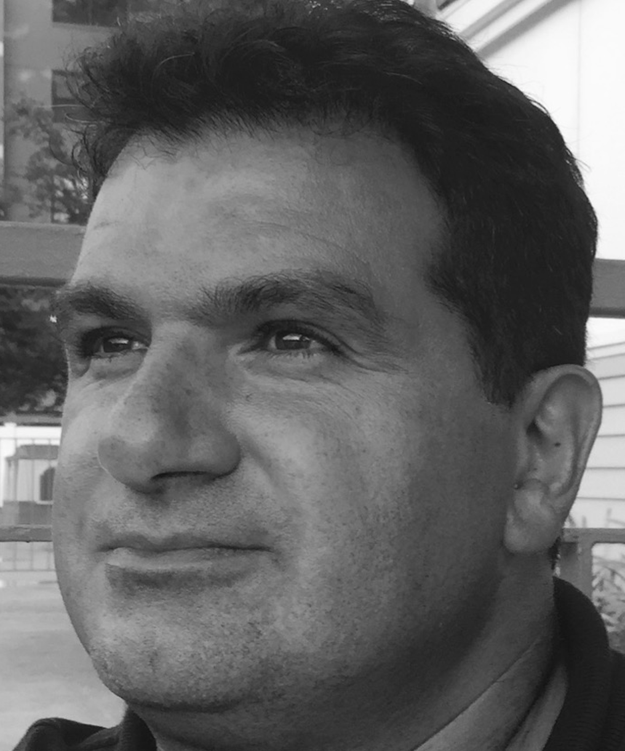
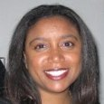
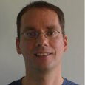
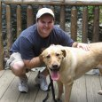

Meet today’s instructors
David Taieb
STSM–Cloud Data Services Developer advocacy
Michele Ogle
Developers Program Lead
Patrick Titzler
Developer Advocate - Cloud Data Services
Steve Johnston
WW Cloud and Developer Programs
Rags Srinivas
IBM Digital Business Group

Slide 3
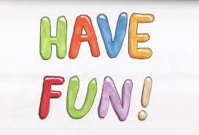
Objectives
In this session, you will:
Be able to understand how software is created
Call yourself a junior Quality Engineer
Call yourself a junior Java Developer
And more importantly:

Slide 4
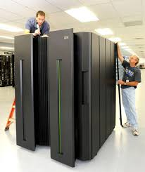

What’s a computer?
Personal Computers
MainFrame

Slide 5
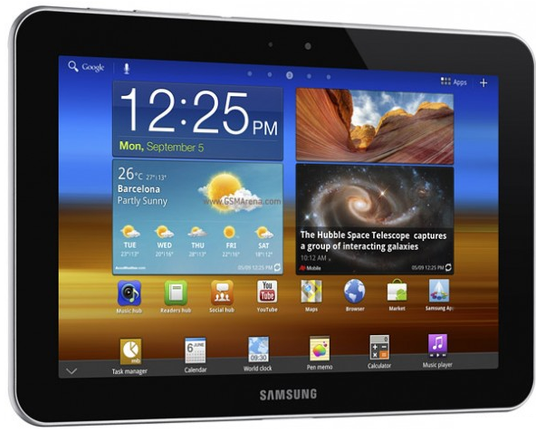
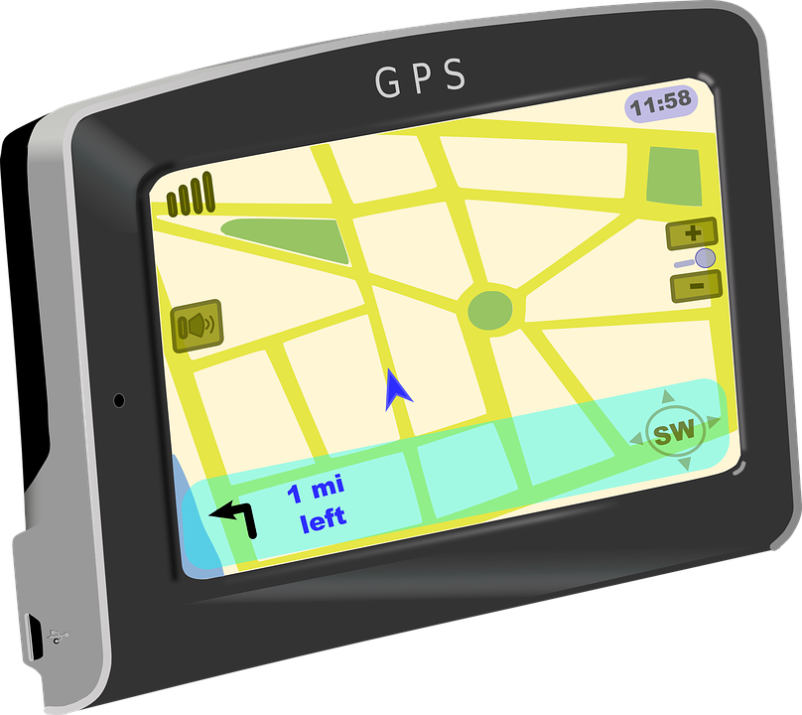
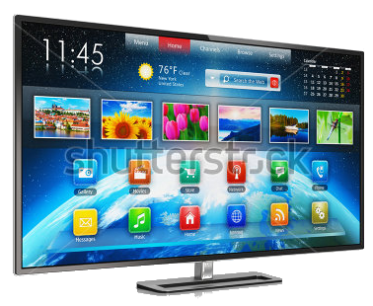
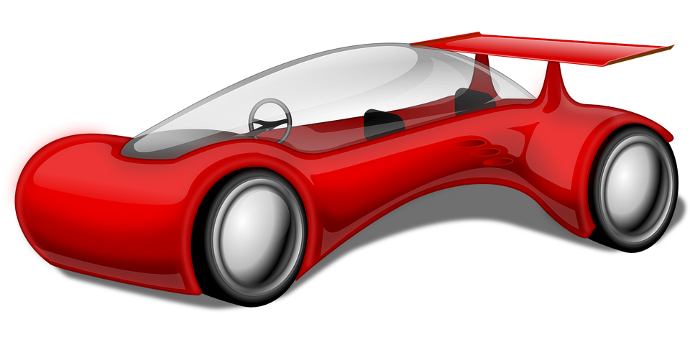
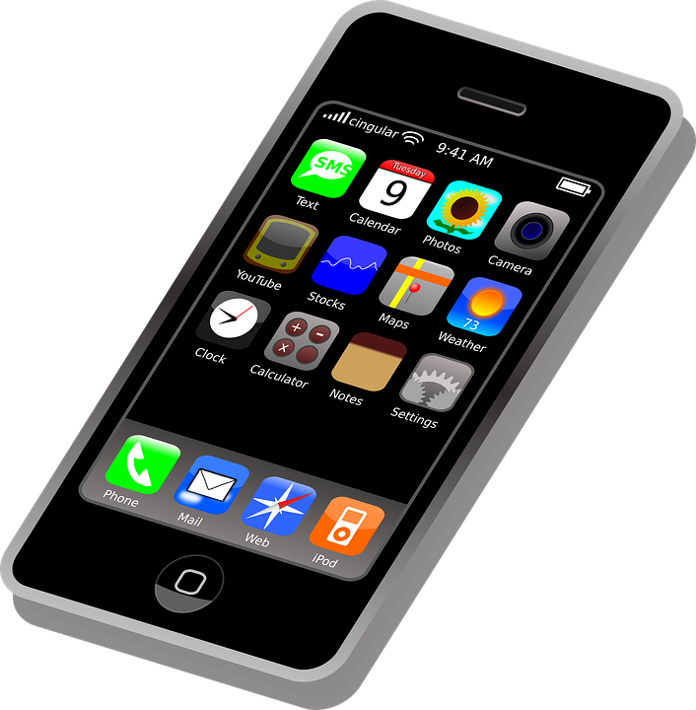

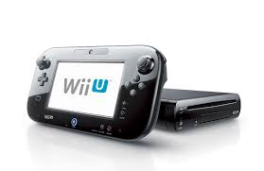
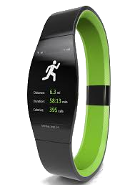
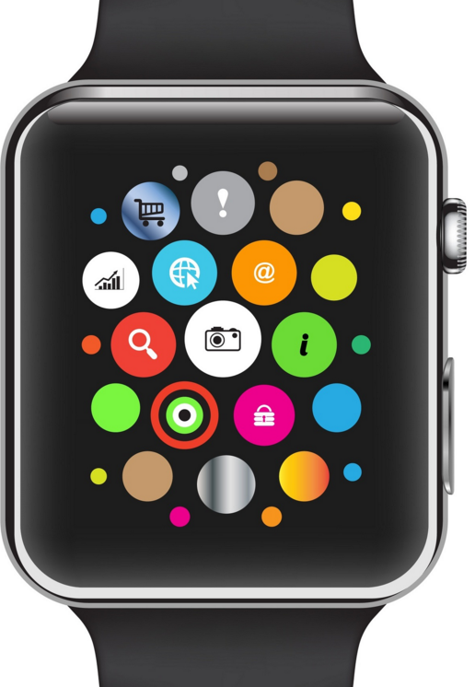
Is that it?
IPAD
GPS
TV
They are computers too!
Cars
Phone
Fitbit
Video Games
IWatch

Slide 6
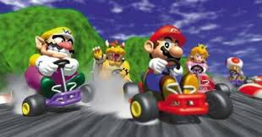

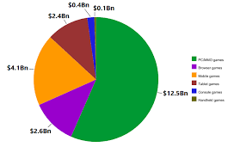
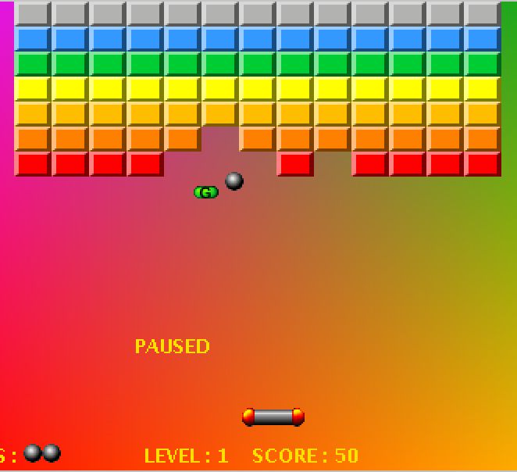
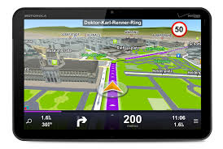
What do computers do?
Software Programs
Output
They run software programs

Slide 7
What’s a computer software program?
A series of steps by steps instructions that tell the computer how to accomplish as task, what actions to perform and how to produce an output

Slide 8
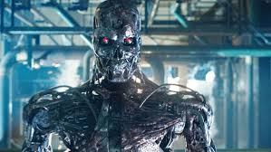
Why do we need to write software, I thought computers were smart?
You must be thinking about this
But sadly No!
Computers are not smart, at least not yet. But they are starting to… Until then, they need to be told what to do.

Slide 9


How do we write software?
Software are written using languages
Pretty much the same way human communicate with each other
public static void main(String[] args) {
System.out.println("Hello World!");
}
Human
Computers

Slide 10

Do computers understand english?
No! computers have their own languages which is made of 0 and 1

Slide 11
But you said programming languages looks like english?
Yes! but they need to be transformed in 0 and 1 before a computer can understand them. For that we use what we call “Compilers”
public static void main(String[] args) {
System.out.println("Hello World!");
}
Compiler
Execute

Slide 12
Why does my computer freeze sometimes?
Excellent question! We said before, that computers do what they are told, but sometimes there is an error in the code making the computer do crazy things.
When this happens, we say there is a bug in the software.

Slide 13
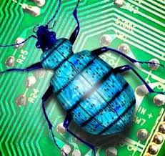
A bug!

Slide 14
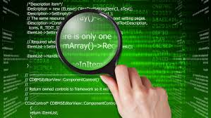
No, more something like this

Slide 15
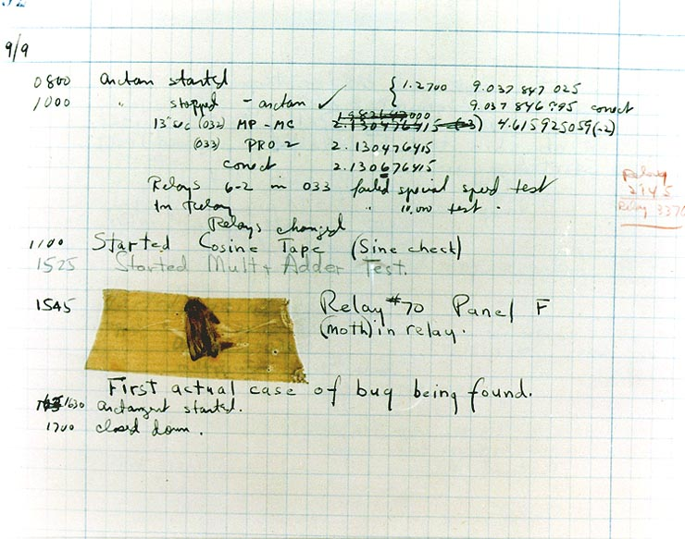
Why do we call them bug?
In 1946, computer parts were a lot bigger than today. One day, an engineer named Grace Hopper found a moth in her computer which caused it to malfunction. We use the term bug ever since!

Slide 16
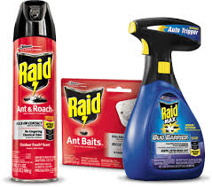
So how do we get rid of bugs?

Slide 17


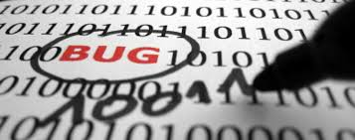
How do we get rid of bugs?
That’s the role of Quality engineers, which you will be today
Here’s how it works
When a bug is found
Developer writes code
Tester look for bug
send it back to developer for fixing

Slide 18
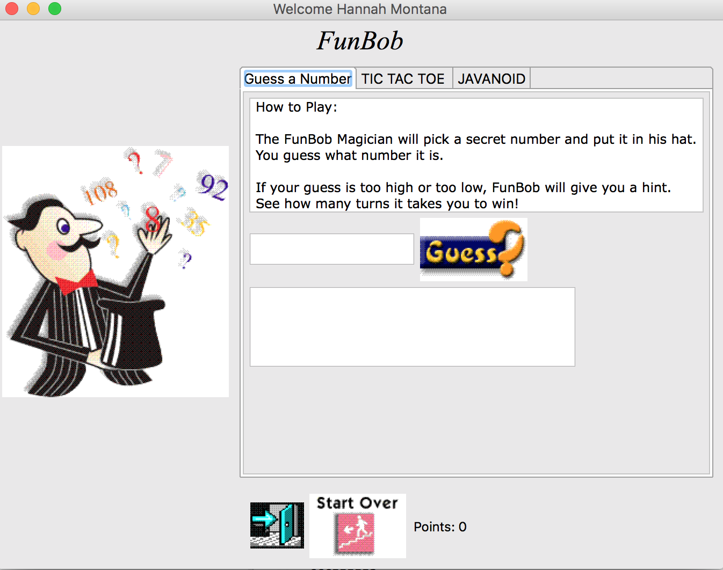
That brings us to the fun part of today
You will use a game called Funbob
Funbob has lots of bugs
You will have 20 mns o find as many as possible.
Write them down on a piece of paper or in a word document

Slide 19
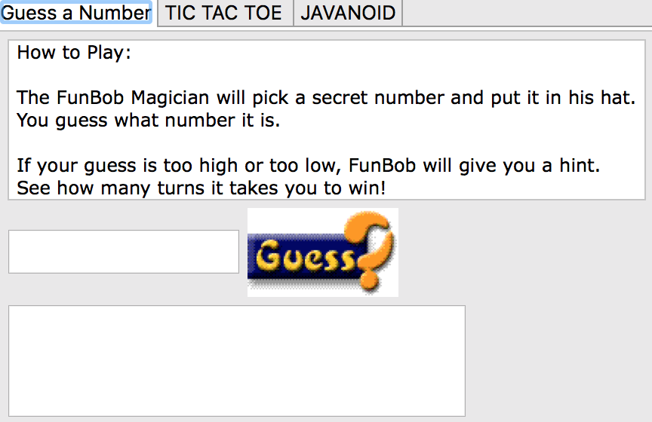
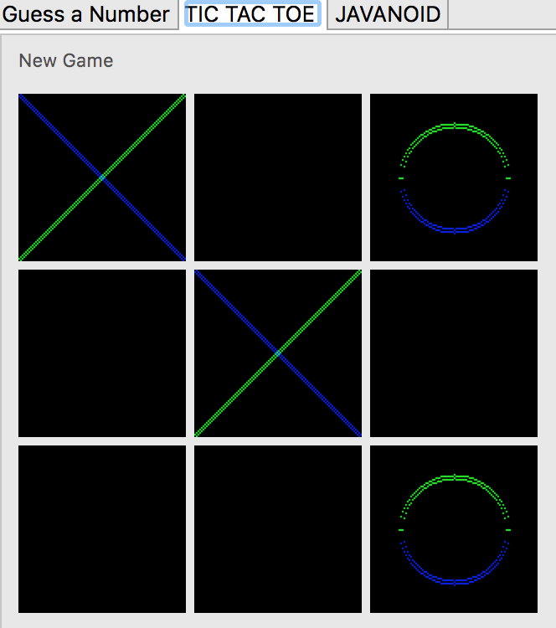
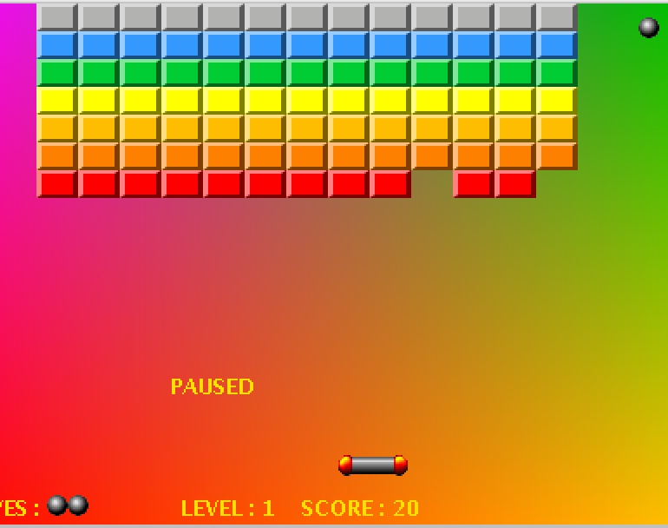
So let’s start!
Click on the Funbob icon
There are 3 games:
GuessMyNumber: you must guess a number between 1 and 10. The computer will tell you if it’s too high or too low
Tic-Tac-Toe: Be the first to make 3 in a row
Javanoid: Kill all the blocks to go to the next level

Slide 20

Remember: You have 20 mns
Be creative and look everywhere

Slide 21
Let’s fix some bugs
Wrong message when clicking on Hat and mustache
Weird window caption title e.g. Welcome Hannah Montana
Bad error message when entering something that is not a number in GuessMyNumber

Slide 22

What is Eclipse?
Eclipse is a development environment used to help developers write and debug code
There are many others available, but today we’ll be using Eclipse to fix the bugs
To start: Double click on the eclipse icon on your desktop

Slide 23
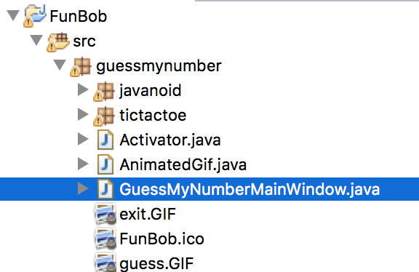
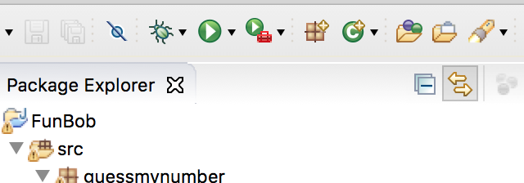
Prepare to squash the bugs!
Open GuessMyNumberMainWindow.java
Run the app from Eclipse

Slide 24
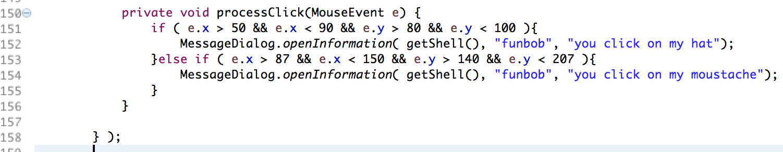
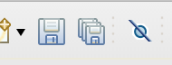
Fix the mustache vs hat message
Switch the 2 messages
Save the GuessMyNumberMainWindow file
Run the app from Eclipse

Slide 25
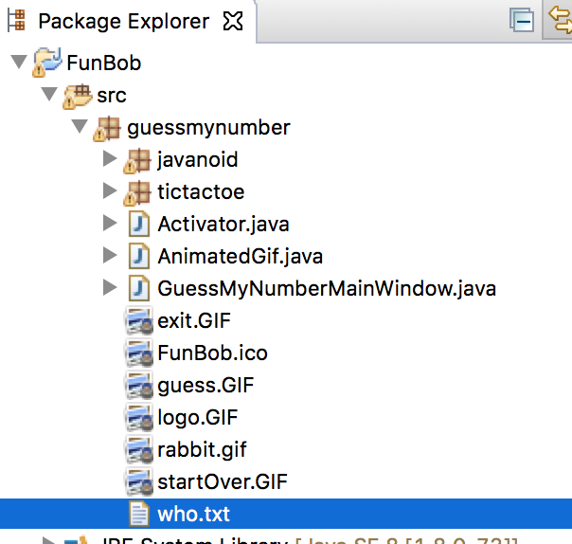
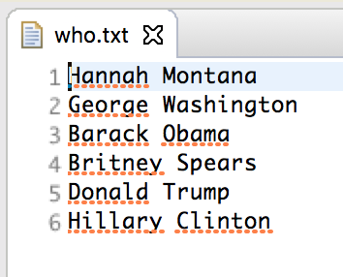
Fix the weird window title
Double click on who.txt
Change the names as you wish
Save the file and restart Funbob

Slide 26
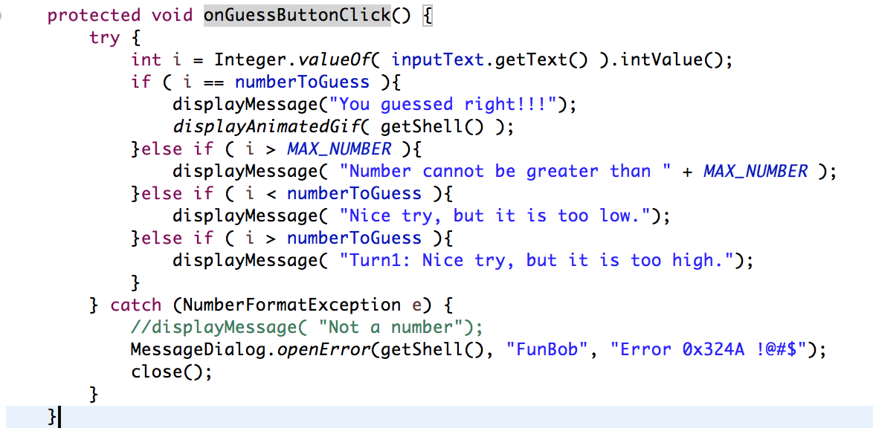
Fix the bad error message
Open GuessMyNumberMainWindow.java
Go to onGuessButtonClick (line 326) method and fix the bad error message with a nicer one
Save the file and restart Funbob

Slide 27
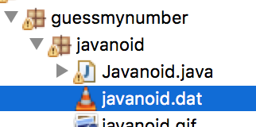
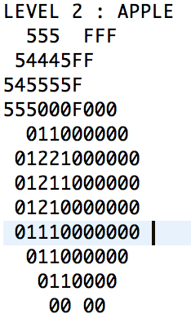
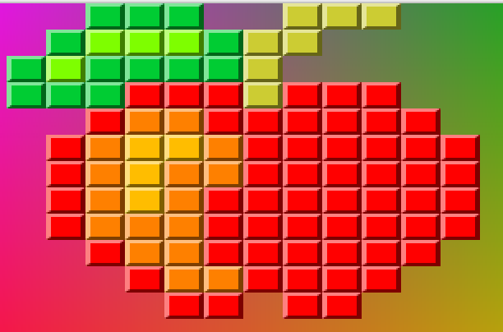
Want to improve the app?
Design your own blocks shape in Javanoid
Open javanoid.dat
Make your own level shape using the codes below
0
1
2
3
4
5
6
7
8
9
A
B
C
D
E
F

Slide 28
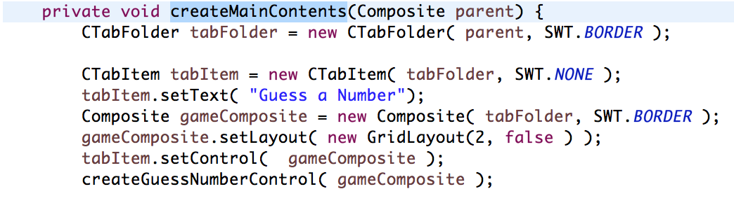
Let’s add a new game
Open GuessMyNumberMainWindow.java
Go to createMainContents method (line 209)

Slide 29
Create a new Tab
Add the following code at the end of method:
tabItem = new CTabItem( tabFolder, SWT.NONE);
tabItem.setText("Fun Games");
Browser browser = new Browser( tabFolder, SWT.BORDER);
browser.setUrl("http://www.tammyyee.com/keiki_page/javascript_games/checkers_/checkers.html");
browser.setLayout( new GridLayout() );
tabItem.setControl( browser );

Slide 30
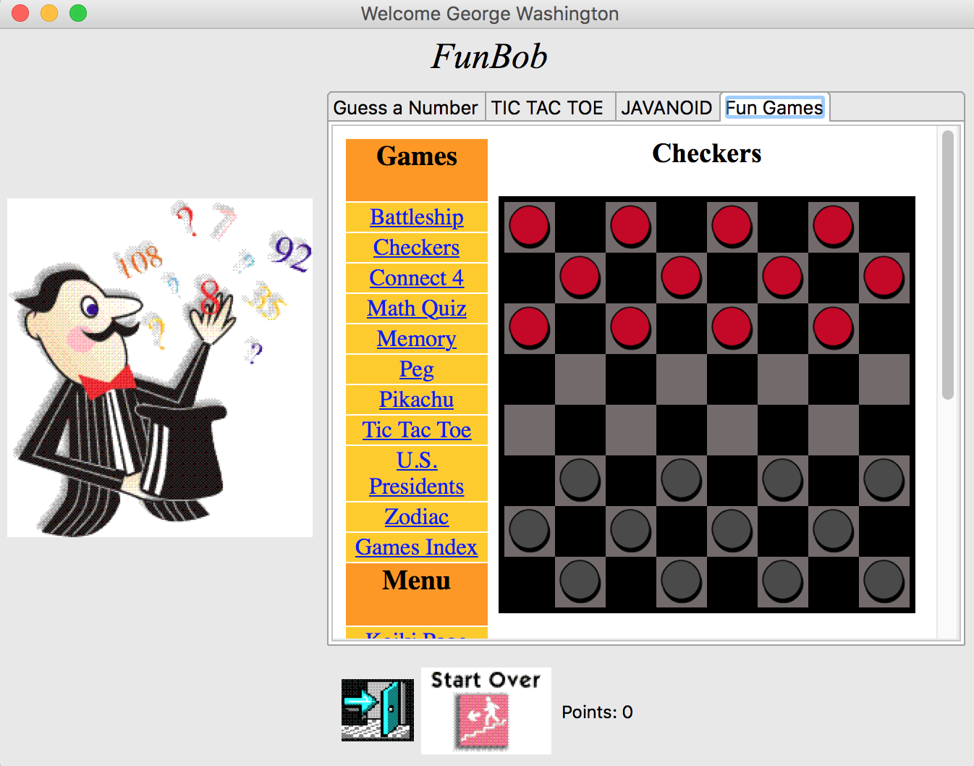
Restart FunBob again

Slide 31

Play the new games, you deserve it!
Let’s play some games!

Slide 32

Steve Johnston
johnstst@us.ibm.com
Michele Ogle
mogle@us.ibm.com
David Taieb
david_taieb@us.ibm.com
Patrick Titzler
ptitzler@us.ibm.com
Rags Srinivas
raghsrin@us.ibm.com
courtesy: http://omogemura.com/

